Slide 1

So You Want to Learn Linux
Jessica Deen
Technical Evangelist - Microsoft
www.jessicadeen.com | @jldeen Jessica.Deen@Microsoft.com

Slide 2
Starting point.
GitHub https://github.com/jldeen/learnlinux
Word document to walk through project
PowerPoint
sites.conf.example file
Learn more about Azure, Cloud, OSS, Linux, PS, etc. http://jessicadeen.com/

Slide 3
Why Linux?
Cost – Free
Security – Some might argue it’s a stronger OS than Windows considering most viruses are written for the Windows platform
Versatility – It can work on extremely old hardware and requires very little computing power (Raspberry Pi)
Software – The vast majority of Linux software is open source and free. Not only is there a zero cost associated, but you can also usually modify the source code and add more features if you have programming experience
Speed – In many cases, Linux distributions are found to be faster and snappier than Windows and Mac

Slide 4
10 Most Popular Linux Distributions
openSUSE / SUSE Linux Enterprise
Community created; sponsored by Novell
Mageia / Mandriva
Fork of Mandriva Linux created in 2011
Arch Linux
Lightweight, minimal
Uses a “rolling release” model
Slackware Linux
Oldest distrio that’s still maintained
Puppy Linux
Latest version built on Slackware
ISO file is only 161 MB
Debian
Composed of only free, open sourced software
Ubuntu
Debian-based
Linux Mint
Built on top of Ubuntu
Fedora
Fedora doesn’t make its own desktop environment or other software. Instead, the Fedora project uses “upstream” software
Comes with GNOME 3, by default
Cent OS / RHEL (Red Hat Enterprise Linux)
Commercial Linux Distribution
Intended for servers and workstations
Notes:
Consider Fedora to be the “consumer” version of RHEL since it’s sponsored by Red Hat and is the foundation for the Red Hat Enterprise Linux project
Arch Linux – Rolling Release - which means any installation image is just a snapshot of the current software. Every bit of software will be updated over time without you needing to upgrade to a new “release” of Arch.

Slide 5
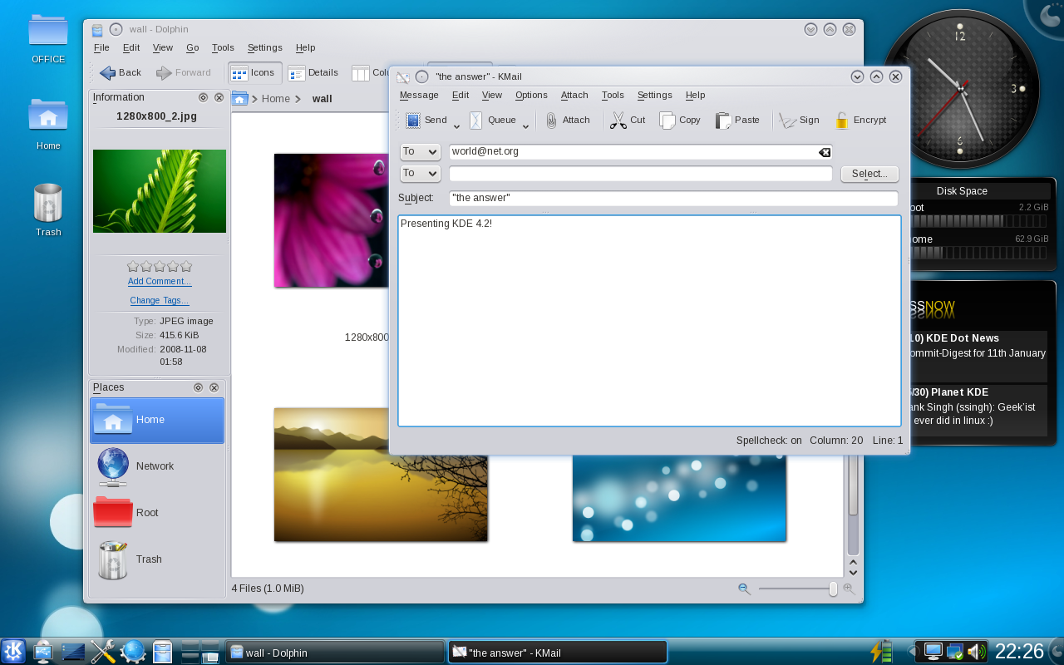
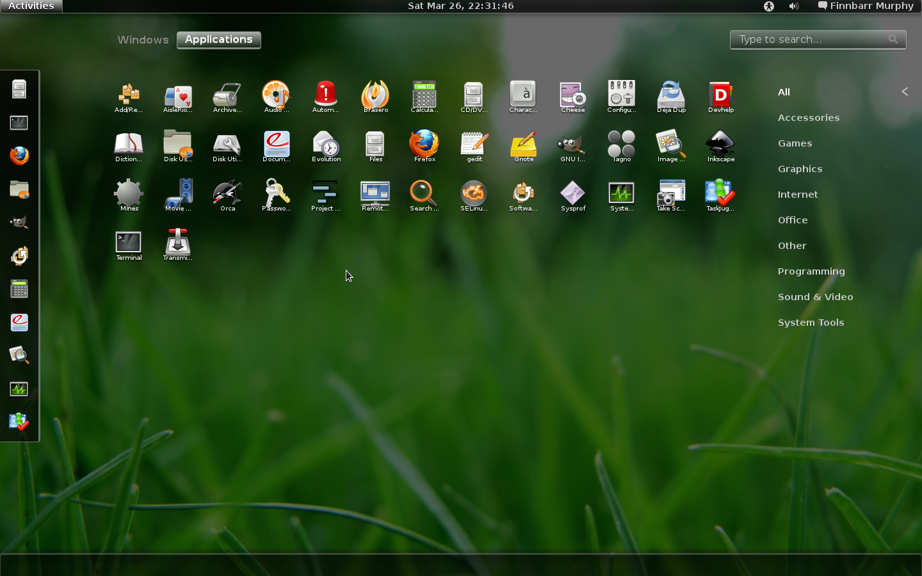
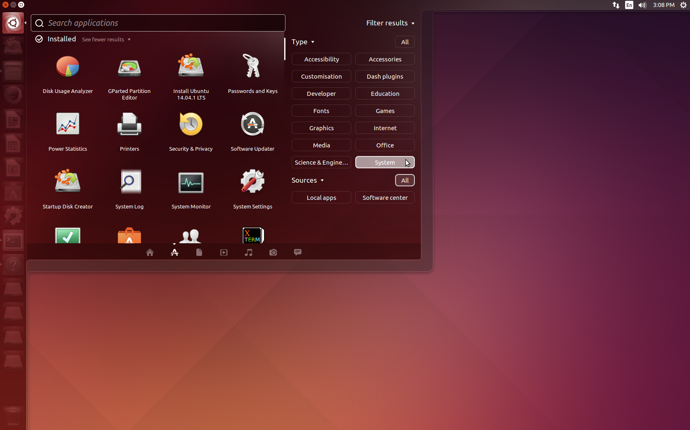
Desktop Environments
Desktop Environments
Think of them like GUIs
XFCE
Gnome
KDE
Unity
Installed by default in 14.04 and 16.04
Cinnamon

Slide 6
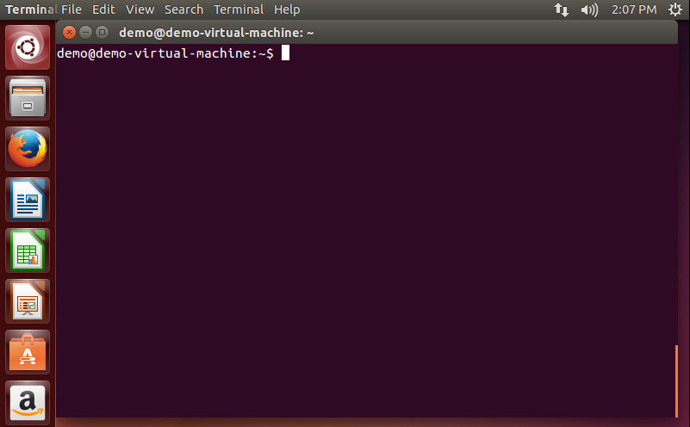
Terminal

Slide 7
Linux (UNIX) Basics Commands
http://jessicadeen.com/tech/microsoft/15-ubuntu-linux-commands-everyone-should-know/
man
“Manual”
ls
“List”
Equivalent to “dir” in CMD
pwd
“Print Working Directory”
sudo
Think of this as UAC – elevate current user to root permissions for specific commands
Text Editors:
nano
vim

Slide 8
Linux (UNIX) Basics Commands (Cont’d)
mv
Move
cp
Copy
crontab
cron table
Think of it like scheduled tasks on Windows Server
history | grep “search string”
Pipe = Sends data from one program to another
Recommend Code Academy’s “Learn the Command Line” course to become more familiar with CLI

Slide 9
Linux vs PowerShell Commands
Linux | PowerShell
tail –f “file path” | Get-Content “file-path” -wait
history | Get-History
(Print the last command) !! | Print the last command – $$
(creates an alias) alias=‘info here’ | (creates an alias) New-Alias -Name grep -Description grep Select-String
ls | ls
mv | mv
pwd | pwd

Slide 10
Software Repositories
What are software repositories?
Storage locations from which software packages may be retrieved and installed on a computer.
Each Linux distribution hosts their own software repositories
Installing software on Linux involves package managers and software repositories
Package manager – Think of it like an app store, except they were the original app store.
Example: sudo apt-get update
Example: sudo apt-get upgrade
Example: sudo apt-get install git
Example: sudo apt-get install vim

Slide 11
Updates
sudo apt-get update
Downloads the package lists from the repositories and "updates" them to get information on the newest versions of packages and their dependencies. It will do this for all repositories and PPAs
sudo apt-get upgrade
Will fetch new versions of packages existing on the machine if APT knows about these new versions by way of apt-get update
Notes:
Pause here to Demo commands

Slide 12
Building a Web Server - Important Considerations
Cost
Apache HTTP is free
Ubuntu is free
Physical or Virtual?
Is your web server going to be setup with physical infrastructure or using a virtual solution such as VMware ESXi or Hyper-V?
What kind of web site will you be deploying?
PHP based
Python based (Django)
HTML
Microsoft .NET (IIS)

Slide 13
LAMP Stack
LAMP = Linux / Apache / MySQL / PHP
Apache HTTP
Around since 1995
Serves an estimated ~55% of all websites (as of June of 2013)
Can run on Windows, Linux, Mac
MySQL
Open source database
Free
PHP
Server side scripting language for web development
Can also be used as a general-purpose programming language

Slide 14
Install packages
To install all necessary tools for your new Web Server, we can type everything we need to install in one single command:
sudo apt-get install apache2 mysql-server mysql-client php7.0-mysql php7.0-curl php7.0-json php7.0-cgi php7.0 libapache2-mod-php7.0 php-cli
sudo service apache2 restart or sudo systemctl restart apache2
Notes:
Libapache2-mod-auth-mysql module for the Apache 2 web server which enables HTTP authentication against information stored in a MySQL database
mcrypt is a replacement for the popular Unix crypt command. crypt was a file encryption tool that used an algorithm very close to the World War II Enigma cipher. Mcrypt provides the same functionality but uses several modern algorithms such as AES. It allows developers to use a wide range of encryption functions, without making drastic changes to their code.

Slide 15
Vhosts and Reverse proxy
Virtual hosting is a method for hosting multiple domain names (with separate handling of each name) on a single server (or pool of servers). This allows one server to share its resources, such as memory and processor cycles, without requiring all services provided to use the same host name.
A reverse proxy (or gateway) appears to the client just like an ordinary web server. No special configuration on the client is necessary. The client makes ordinary requests for content in the namespace of the reverse proxy. The reverse proxy then decides where to send those requests and returns the content as if it were itself the origin.
https://httpd.apache.org/docs/current/mod/mod_proxy.html

Slide 16
DEMO
Notes:
We’ve gone through a journey today, through the various capabilities of Azure that support your path toward digital transformation, from app innovation, to data and intelligence, to open and flexible deployments, to trust. We’re here to partner with you as you continue to innovate and transform. Thank you.

Slide 17
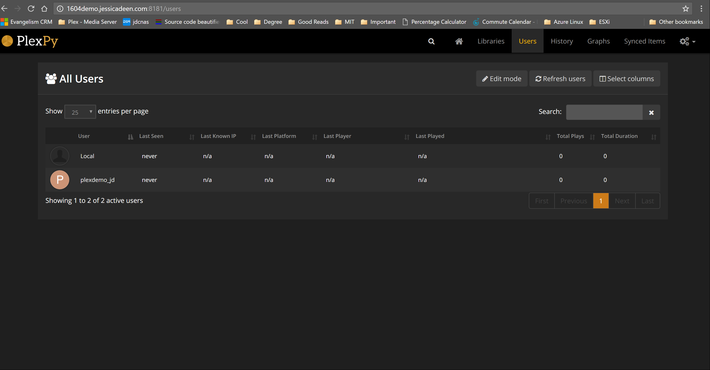
Example of no cifs share
Notes:
Libapache2-mod-auth-mysql module for the Apache 2 web server which enables HTTP authentication against information stored in a MySQL database
mcrypt is a replacement for the popular Unix crypt command. crypt was a file encryption tool that used an algorithm very close to the World War II Enigma cipher. Mcrypt provides the same functionality but uses several modern algorithms such as AES. It allows developers to use a wide range of encryption functions, without making drastic changes to their code.

Slide 18
Q & A
Notes:
We’ve gone through a journey today, through the various capabilities of Azure that support your path toward digital transformation, from app innovation, to data and intelligence, to open and flexible deployments, to trust. We’re here to partner with you as you continue to innovate and transform. Thank you.

Slide 19
What’s next?
GitHub https://github.com/jldeen/learnlinux
Word document to walk through project
PowerPoint
sites.conf.example file
Learn more about Azure, Cloud, OSS, Linux, PS, etc. http://jessicadeen.com/

Slide 20
Thank you
Notes:
We’ve gone through a journey today, through the various capabilities of Azure that support your path toward digital transformation, from app innovation, to data and intelligence, to open and flexible deployments, to trust. We’re here to partner with you as you continue to innovate and transform. Thank you.

